Slide 1
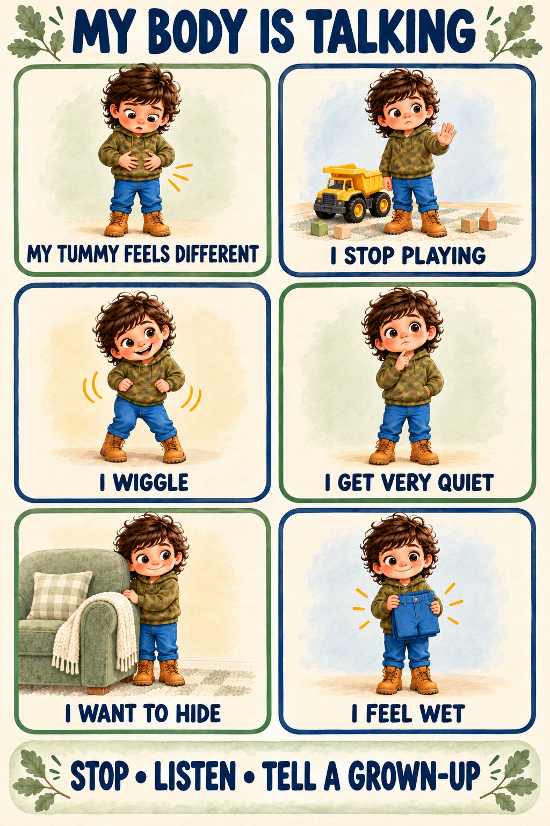
Notes:
Print at 100% on US Letter paper. Laminate or place in a dry-erase sleeve for reuse. Celebrate communication and trying, not only dryness.

Slide 2
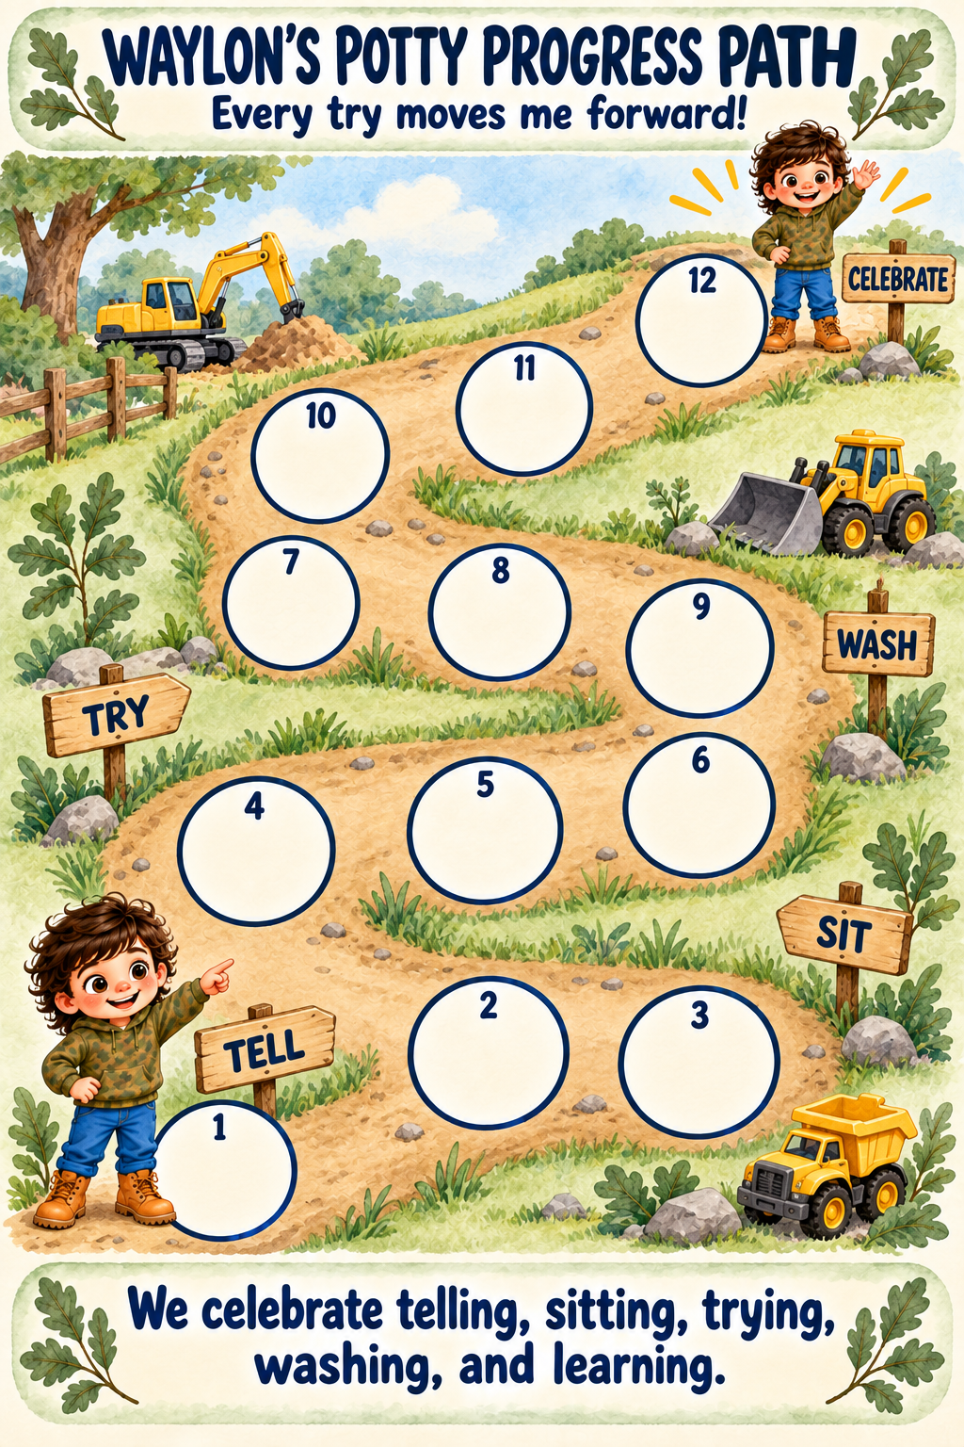
Notes:
Print at 100% on US Letter paper. Laminate or place in a dry-erase sleeve for reuse. Celebrate communication and trying, not only dryness.

Slide 3
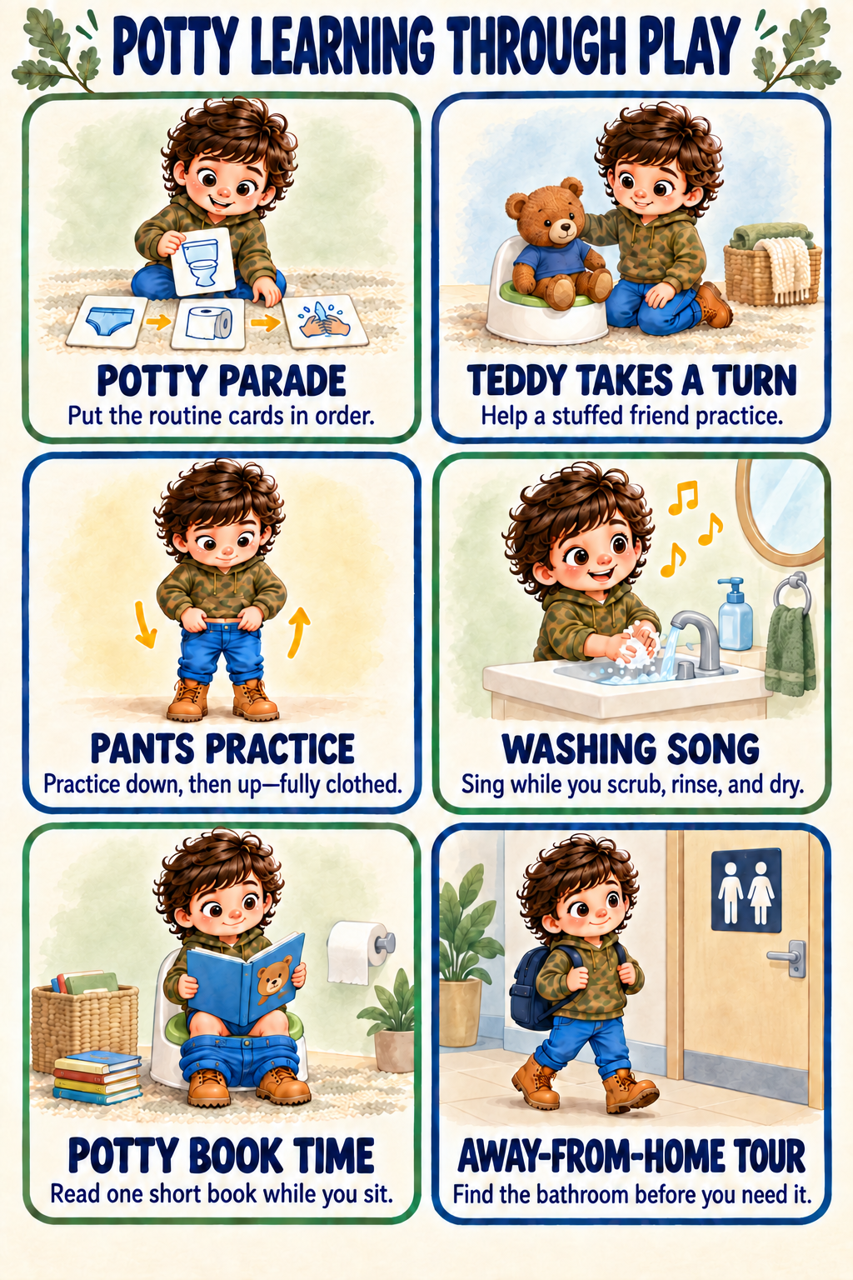
Notes:
Print at 100% on US Letter paper. Laminate or place in a dry-erase sleeve for reuse. Celebrate communication and trying, not only dryness.

