Slide 1
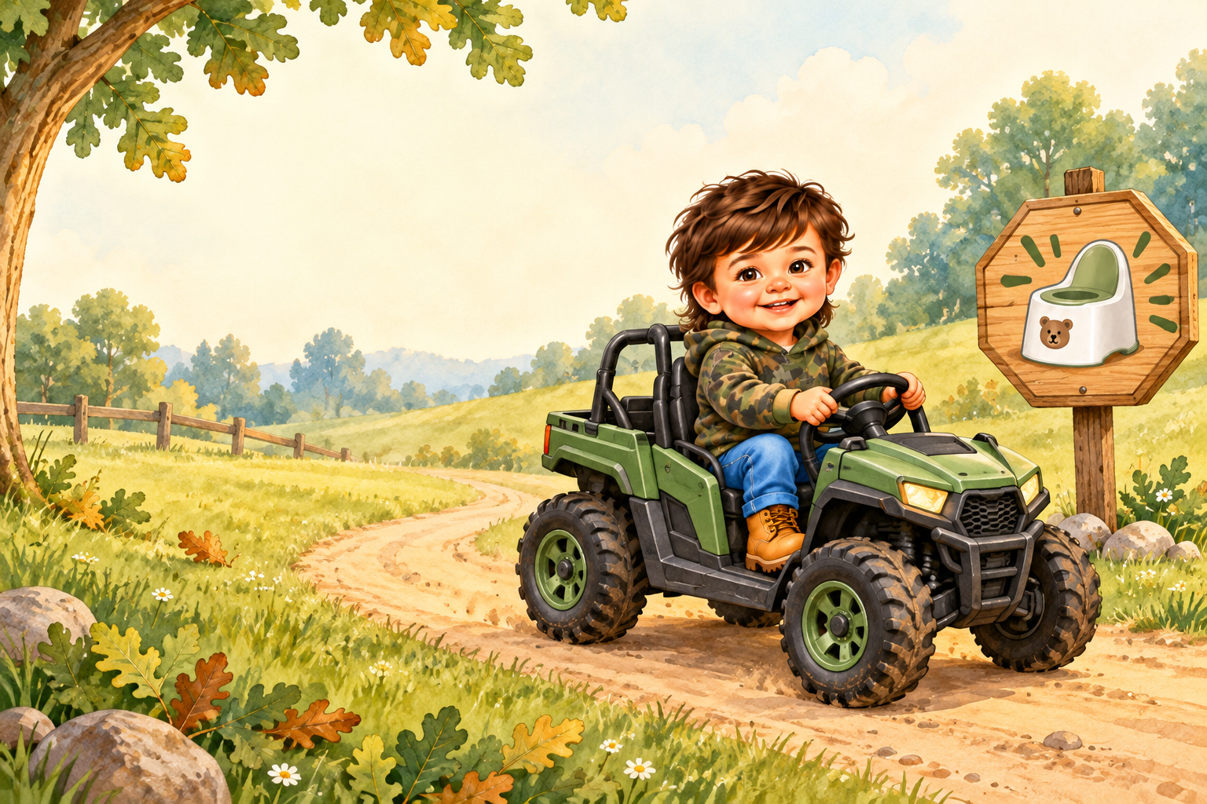
Waylon Makes a
Potty Stop
A Potty Learning Adventure
Notes:
Read the title with excitement. Invite Waylon to find himself, his side-by-side, and the potty sign.

Slide 2
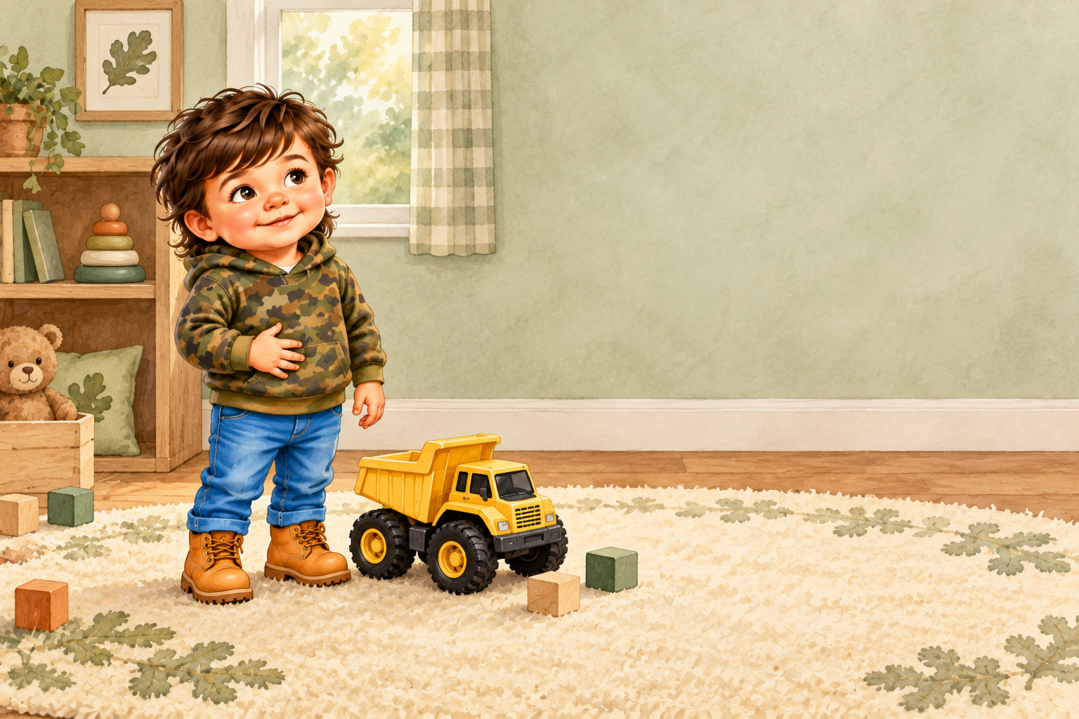
Waylon loves to play
with his dump truck.
Then his body sends
a little message:
“Potty time!”
Notes:
Point to Waylon’s hand on his tummy. Ask: What is Waylon’s body telling him?

Slide 3
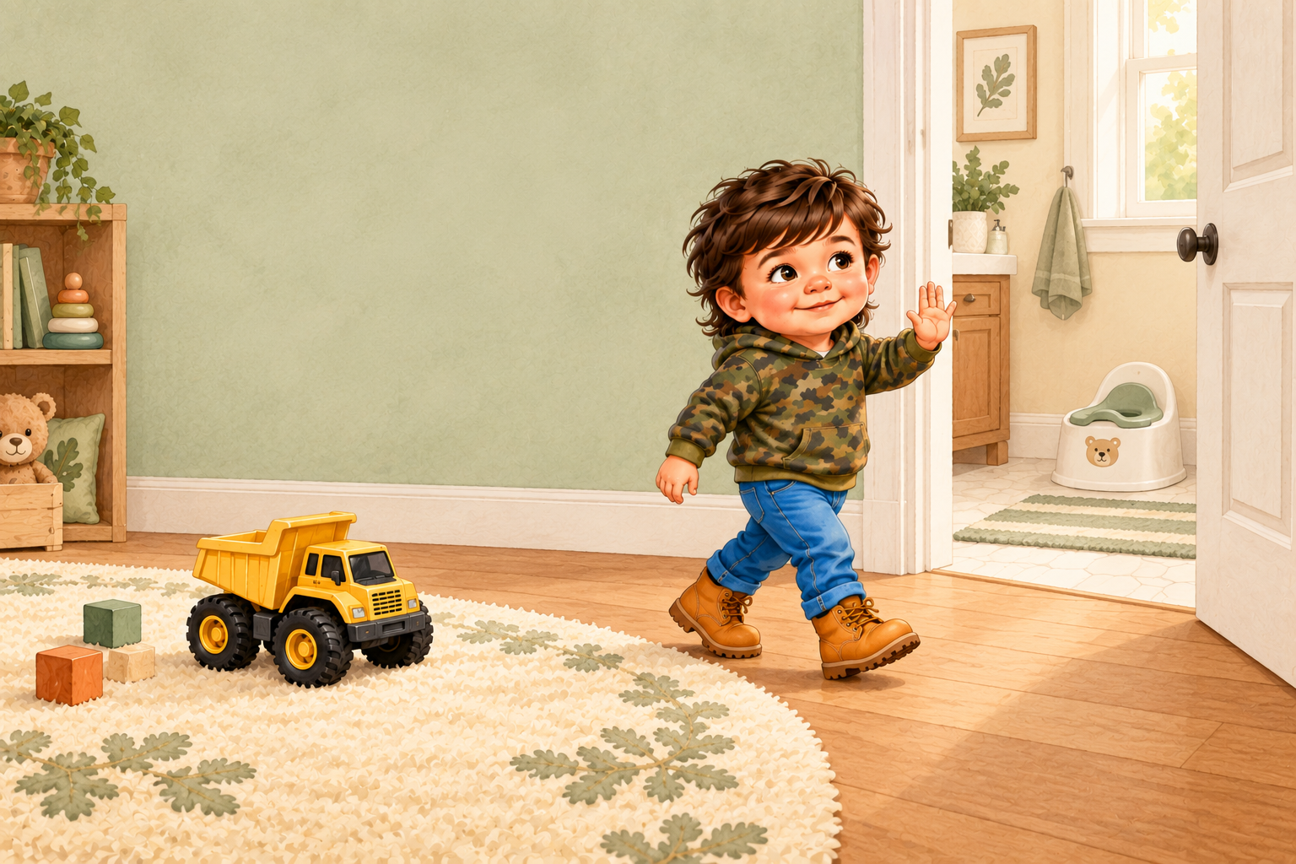
Waylon stops his play.
“I need to go,” he says.
His truck can wait.
Notes:
Practice the words together: I need to go.

Slide 4
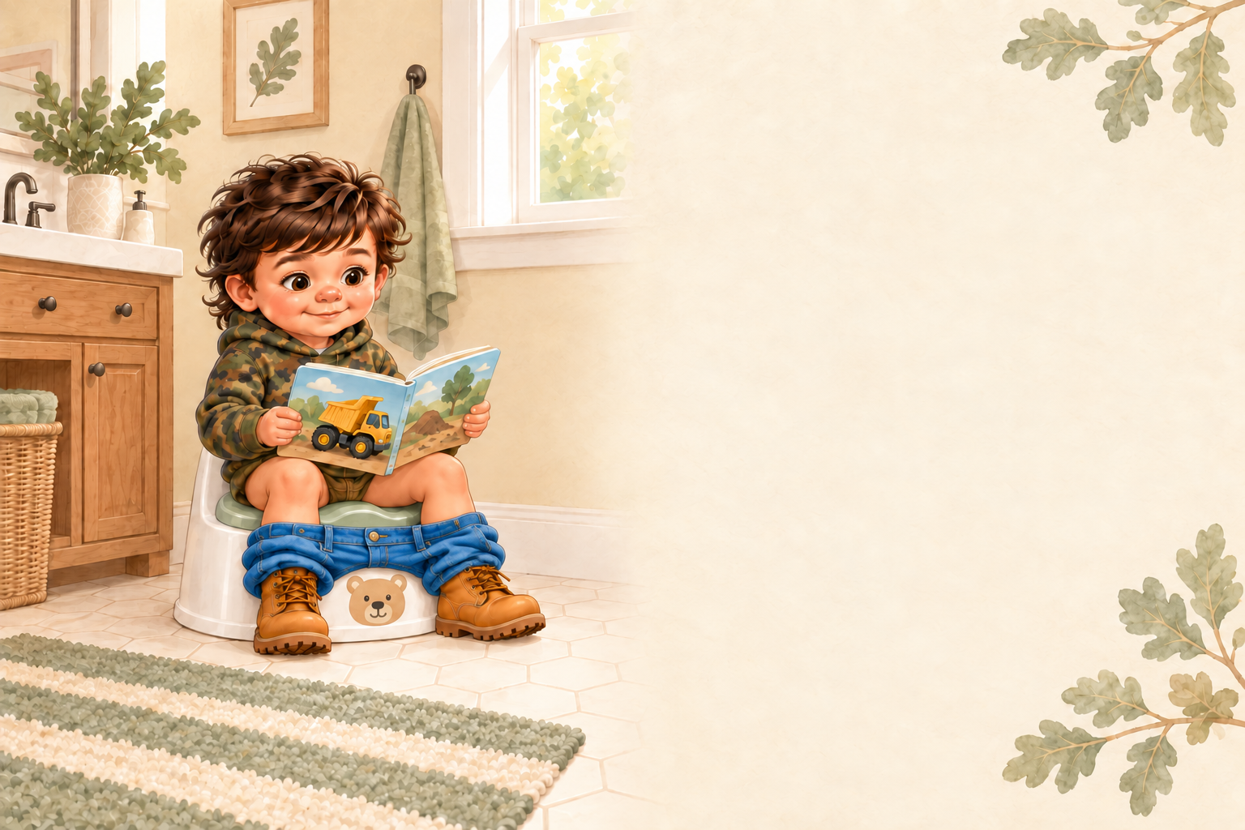
Waylon sits and tries.
Sometimes pee comes.
Sometimes it does not.
Every calm try helps
Waylon learn.
Notes:
Keep this page light and calm. Sitting and trying count as success.

Slide 5
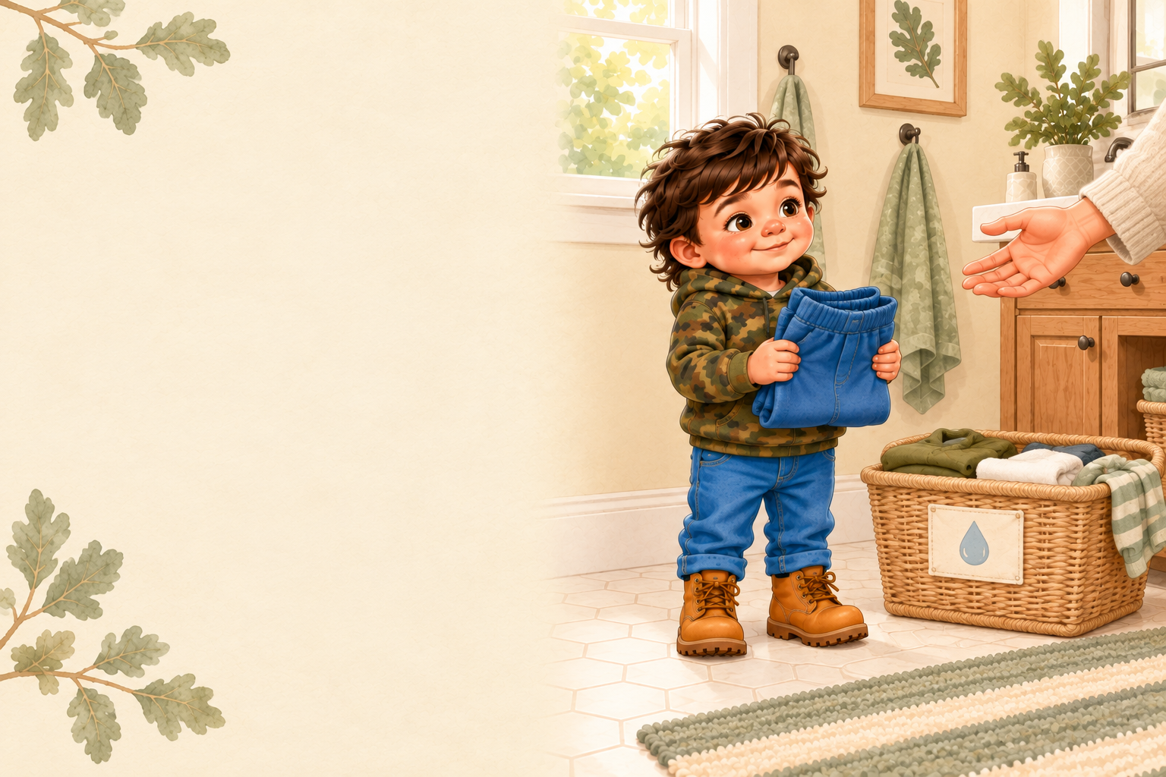
Sometimes Waylon
has an accident.
Accidents are part
of learning.
A grown-up helps him
get clean and comfortable.
Notes:
Use a warm, matter-of-fact voice. Avoid disappointment or urgency.

Slide 6
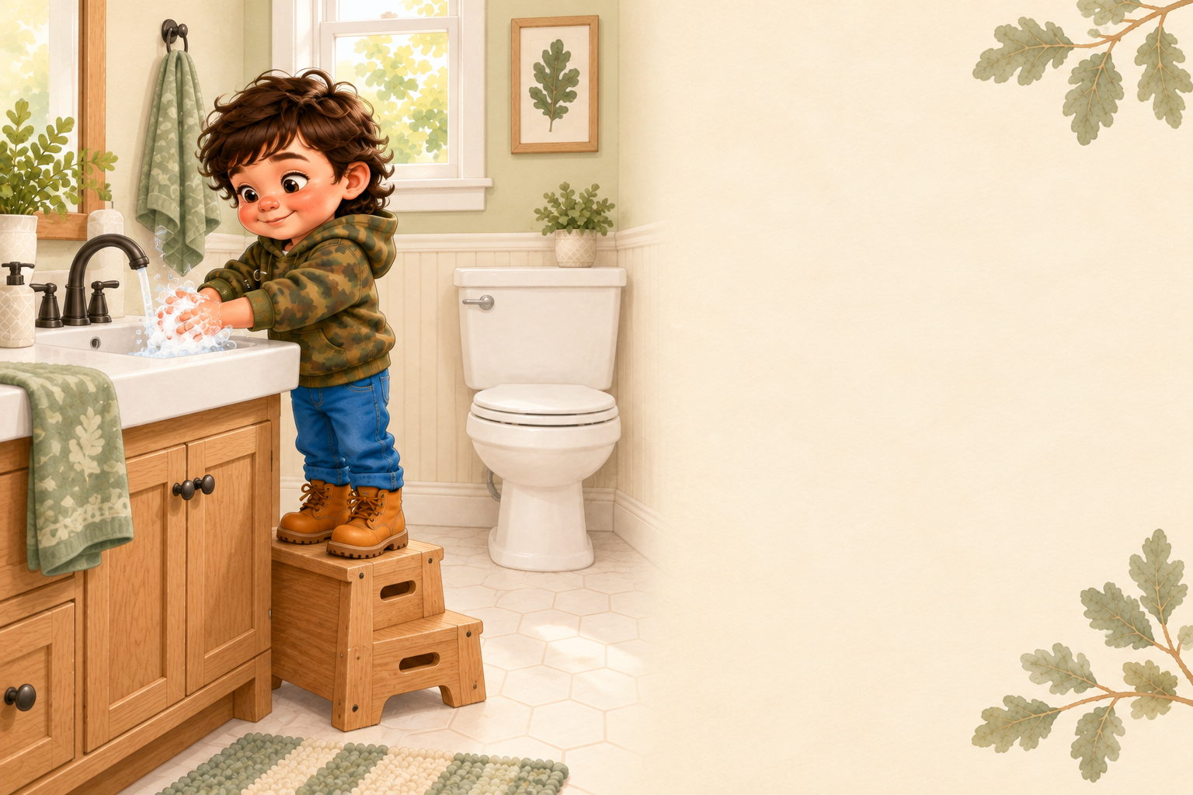
Waylon flushes.
Then he washes his hands
with soap and water.
Clean hands are the last
potty step.
Notes:
Invite Waylon to rub his hands together while you read this page.

Slide 7
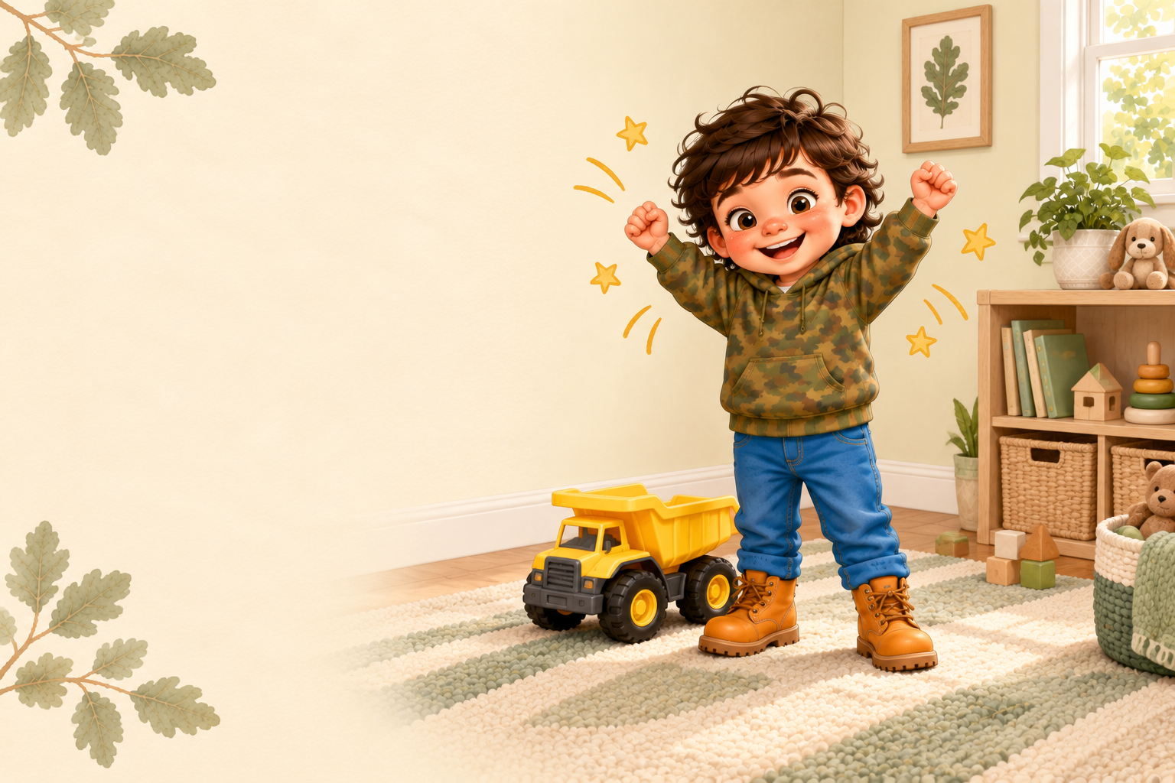
Waylon listened
to his body.
Waylon stopped and tried.
Hooray for Waylon!
Notes:
Celebrate the effort. Say together: I listened. I stopped. I tried!

